Slide 1

RESEARCH DESIGN
PA 604
PROFESSOR BURREL VANN JR

Slide 2

Designing Social Research
Develop Question(s)
Select Purpose for Investigation
Select Method for Answering Question
Decide Unit of Analysis
Data Collection & Analysis

Slide 3
1A) DEVELOP RESEARCH QUESTION ABOUT SOCIAL WORLD
X IS RELATED TO Y

Slide 4
1B) SELECT PURPOSE FOR INVESTIGATING SOCIAL WORLD
Exploration
Description
Explanation

Slide 5
THREE PURPOSES OF RESEARCH
EXPLORATION
DESCRIPTION
EXPLANATION
Satisfy researcher’s curiosity
Test feasibility of doing extensive study
Develop methods for subsequent study
Describe situations and events through scientific observation
Answers questions of why variables (X and Y) are related, and why patterns exist

Slide 6

TYPES OF EXPLANATORY RESEARCH
Idiographic
Nomothetic
EXPLANATION THAT EXHAUSTS THE MANY IDIOSYNCRATIC CAUSES FOR A PARTICULAR EVENT
EXPLANATION THAT IDENTIFIES ONE OR A FEW CAUSAL FACTORS THAT GENERALLY IMPACT A CLASS OF EVENTS

Slide 7
EXAMPLE: MARIJUANA OPINIONS
Idiographic
Nomothetic
ASKING ONE PERSON WHAT INFLUENCED HER VIEWS:
PARENTS, TEACHERS, CLERGY, PREVIOUS EXPERIENCES
FINDING OUT ABOUT THE NUMEROUS (CROSS-CUTTING) FACTORS THAT INFLUENCE GENERAL OPINION
POLITICAL ORIENTATION, GENDER, OCCUPATION, EDUCATION

Slide 8
Criteria for Causality
CORRELATION
X PRECEDES Y
NON-SPURIOUS
X and Y are correlated
The presumed cause (X variable) takes place before the effect (Y variable)
The relationship b/w X and Y are non-spurious (cannot be the result of some other unmeasured variable)
Notes:
Correlation – An empirical relationship between two variables such that changes in one are associated with changes in the other, or particular attributes in one are associated with particular attributes in the other.
Cause/Effect – Time ordering.
Spuriousness – the relationship between two variables must be non-spurious, meaning that the relationship between the two cannot be explained by a third variable (e.g. the positive correlation between shoe size and math skill is actually explained by age or how as age increases, shoe size increases, and also how when age increases, math skill tends to increase).

Slide 9
2) SELECT METHOD OF INVESTIGATION
INTERVIEWS
SURVEYS
FOCUS GROUPS
CASE STUDIES
ETHNOGRAPHY
EXPERIMENT
PARTICIPANT-OBSERVATION
CONTENT/TEXT ANALYSIS
ANALYSIS OF PREVIOUSLY ADMINISTERED SURVEYS
CENSUS
PUBLICLY-AVAILABLE DATA (WHERE PARTICIPANTS REMAIN ANONYMOUS)

Slide 10
3) UNIT OF ANALYSIS
INDIVIDUALS
STUDENTS, VOTERS, PARENTS, CHILDREN
GROUPS
GANG MEMBERS, FAMILIES, MARRIED COUPLES, FRIENDSHIP GROUPS
ORGANIZATIONS
CORPORATIONS, SOCIAL ORGANIZATIONS, COLLEGES
SOCIAL INTERACTIONS
TELEPHONE CALLS, DANCES, ONLINE CHAT ROOMS, FIGHTS
SOCIAL ARTIFACTS
SOCIAL ARTIFACT – ANY PRODUCT OF SOCIAL BEINGS OR THEIR BEHAVIOR.
Notes:
Faulty reasoning
The Ecological Fallacy
erroneously drawing conclusions about individuals solely from the observations of larger units of analysis.
Ecological fallacy – saying something that you find about blacks at the county level is true for all black individuals in that county. Ex: we find that younger precincts tended to show greater support for the female candidate. Saying that youth or young voters supported the candidate is wrong, since it could have been older voters in relatively young precincts holding the relationship.
Reductionism
erroneously drawing conclusions about a phenomenon by looking at aspects of lower level concepts.
Reductionism: predicting the teams that will win the NBA title by looking at the individual strengths of individual players (because you are leaving out critical group-level aspects, including ownership, coaching, loyalty, facility, funding, etc).

Slide 11
4) DATA COLLECTION
CROSS-SECTIONAL STUDY
A STUDY BASED ON OBSERVATIONS REPRESENTING A SINGLE POINT IN TIME, A CROSS SECTION OF A POPULATION.
LONGITUDINAL STUDY
A STUDY DESIGN INVOLVING THE COLLECTION OF DATA AT DIFFERENT POINTS IN TIME.

Slide 12
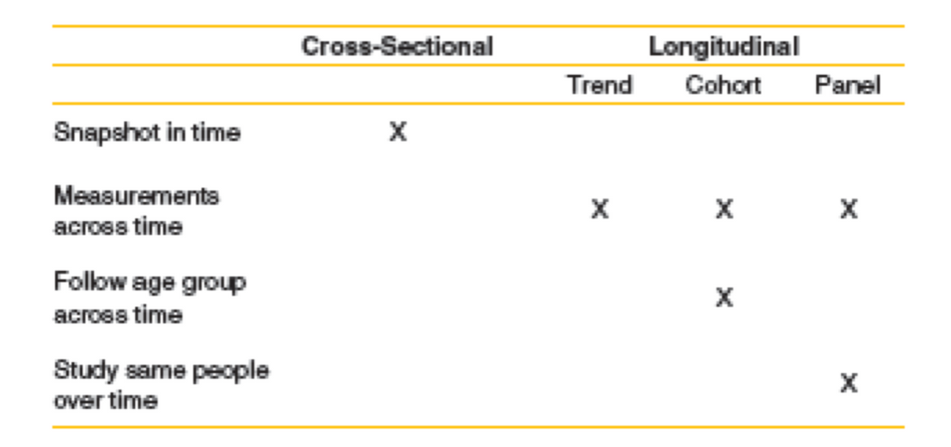
TREND STUDY
Types of Longitudinal Designs
A study in which a given characteristic of some population is monitored over time.
Example: Looks at general shifts in religious affiliation over time.
COHORT STUDY
A study in which some specific subpopulation, or cohort, is studied over time.
Example: Follows shifts in religious affiliation among those born during the Depression.
PANEL STUDY
A study in which data are collected from the same set of people at several points in time
Example: Follows the shifts in religious affiliation among a specific group of people over time.

